Slide 1
Image-Based Situation Awareness
Sakari Lampola

Slide 2
Sakari Lampola
Master of Science 1983 (TTKK, system theory)
TTKK 1980-1983 (assistant, researcher)
Tampereen Sähkölaitos 1980-1982 (student trainee)
Imatran Voima Oy 1984-1988 (team leader)
Kymenlaakso University of Applied Sciences 1988-1991 (teacher)
Oy Cybersoft Ab 1989-2012

Slide 3
Motivation: Understanding Image

Slide 4
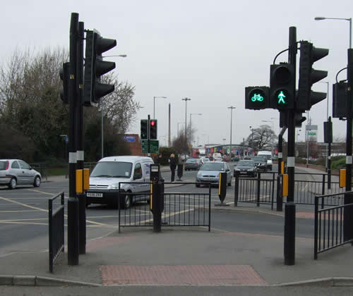
Understanding leads to action

Slide 5
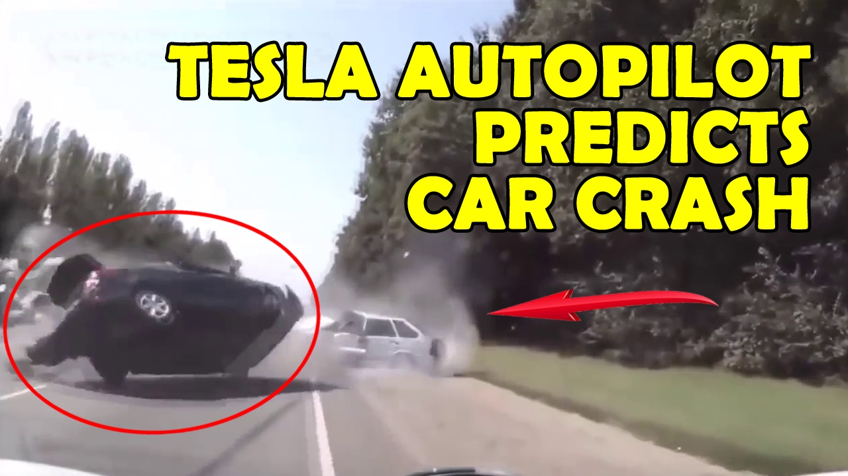
Understanding enables prediction

Slide 6
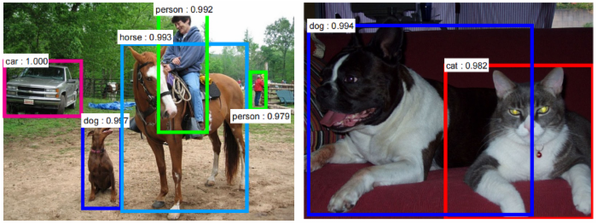
Object detection helps understanding

Slide 7
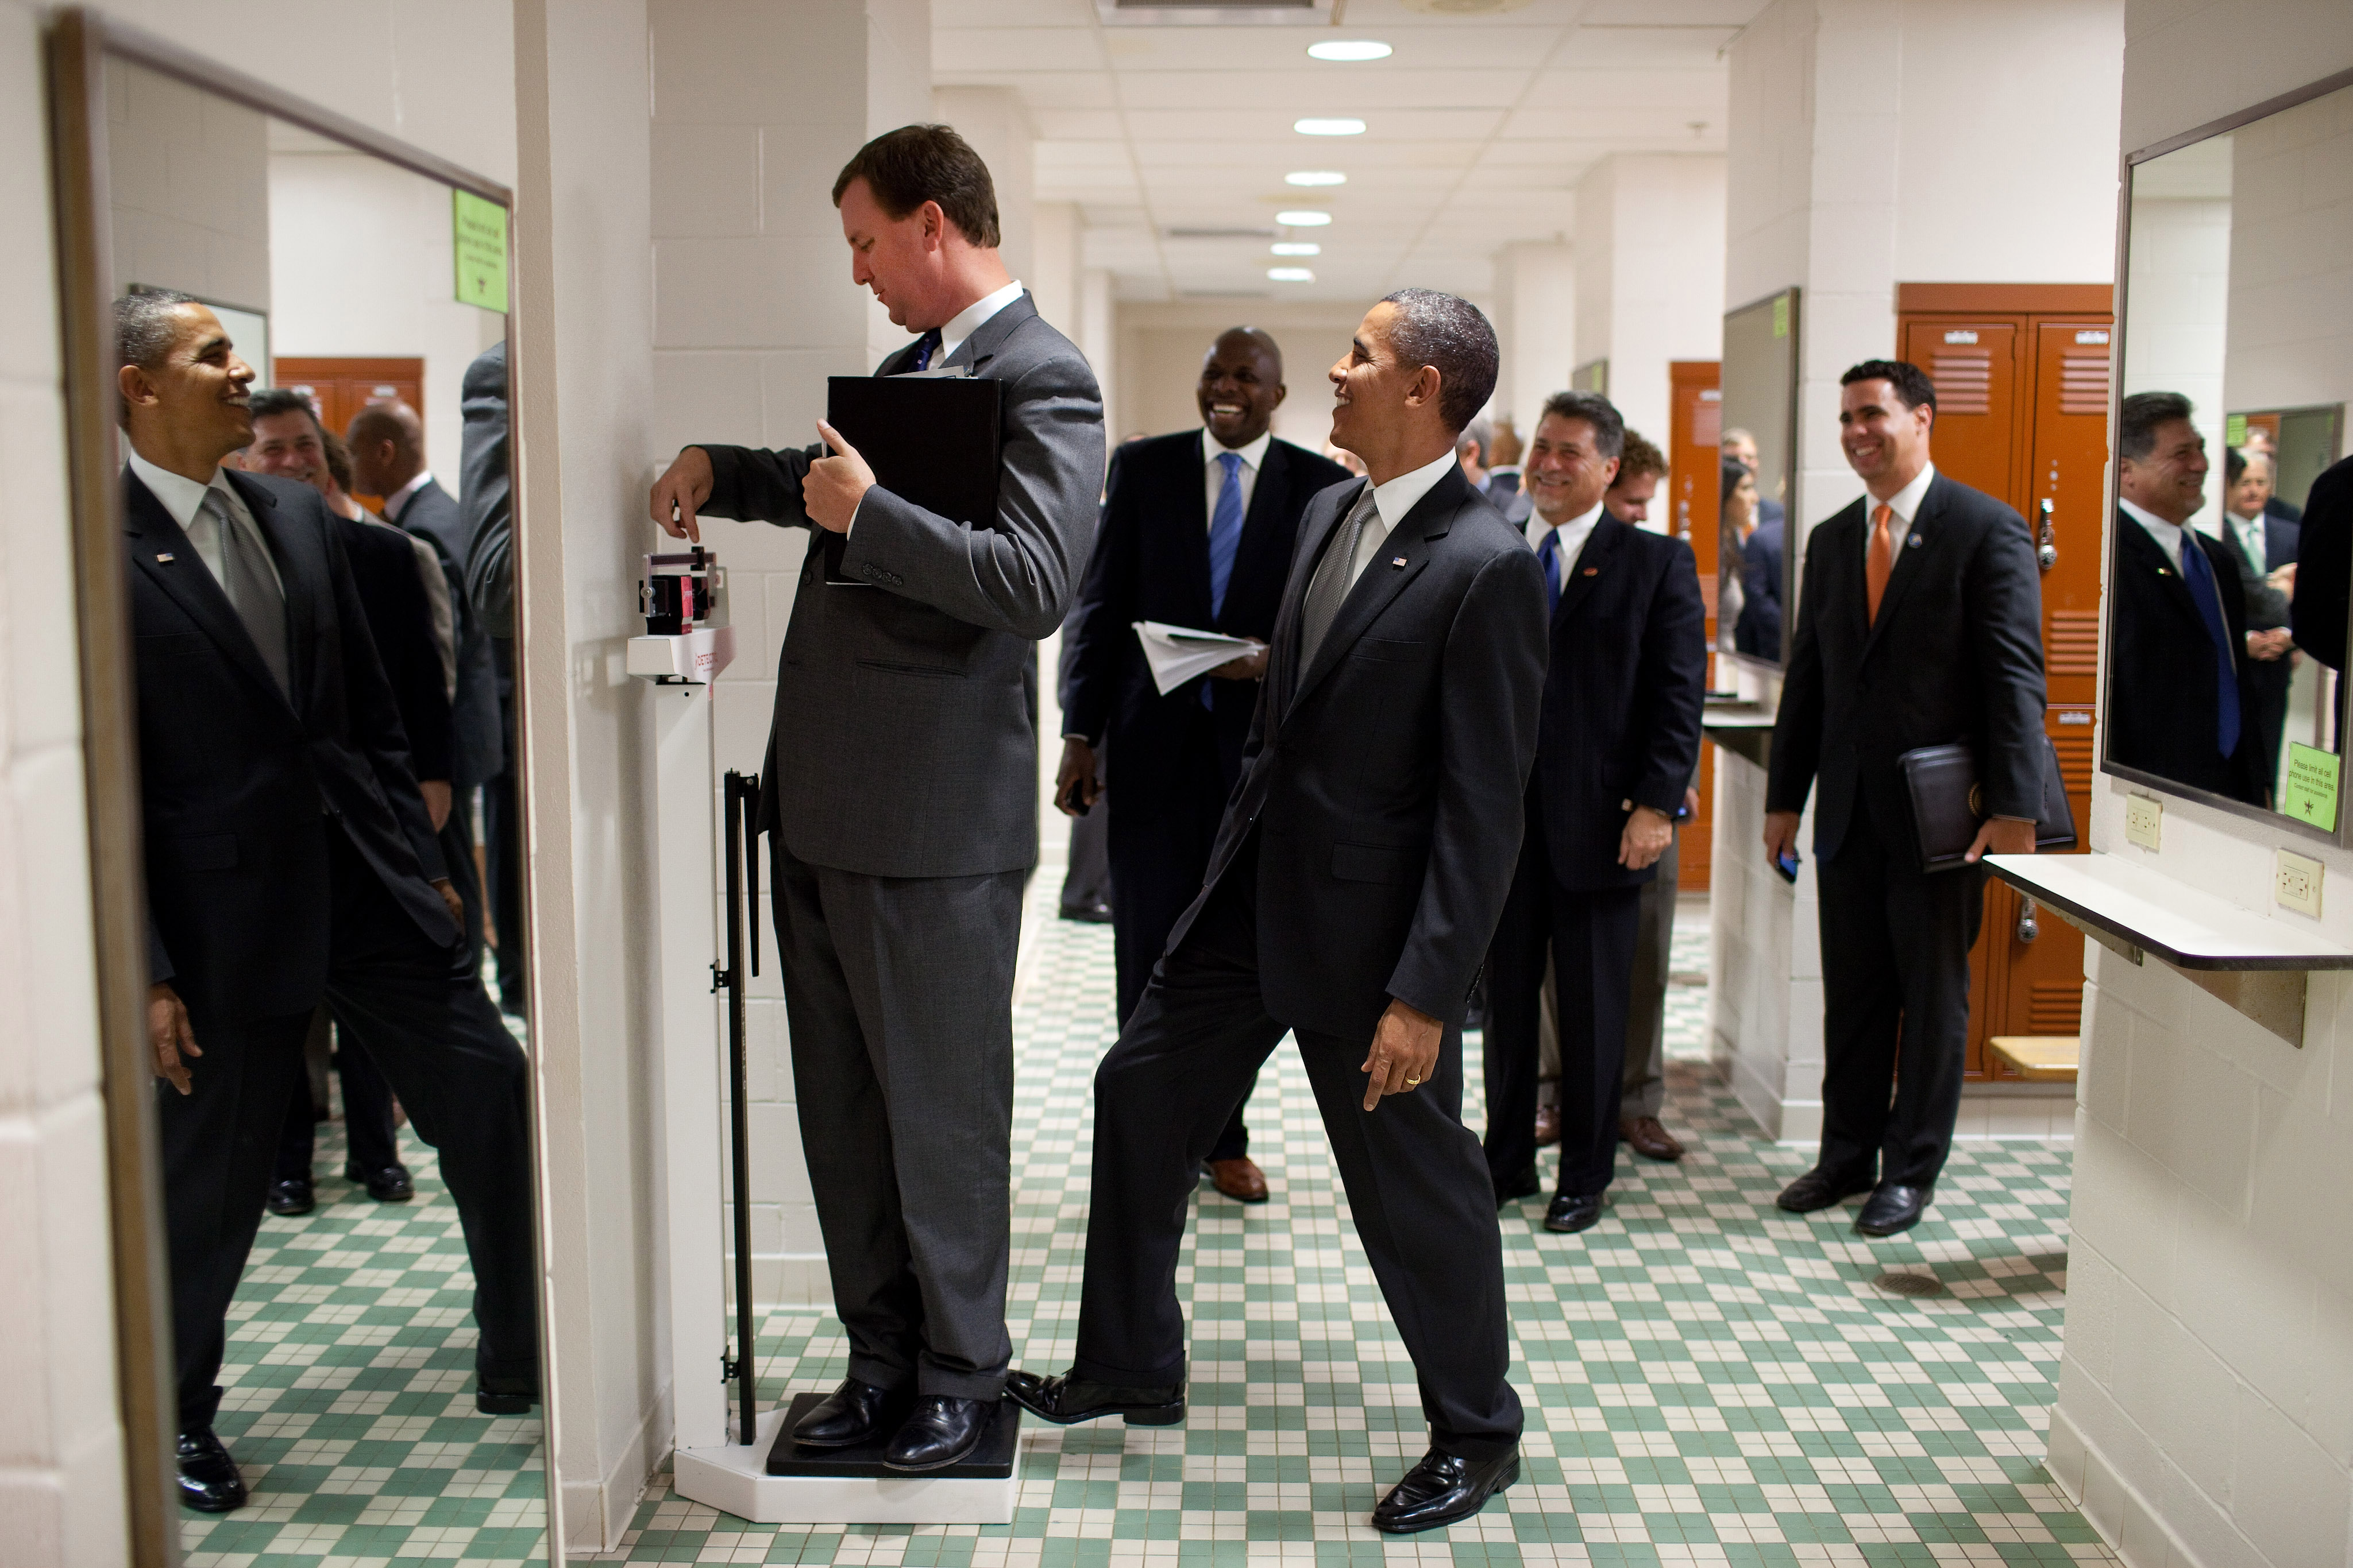
Beyond state of the art
External knowledge
Expectations
Probabilities
Emotions
…

Slide 8
Understanding Image: Image Captioning

Slide 9
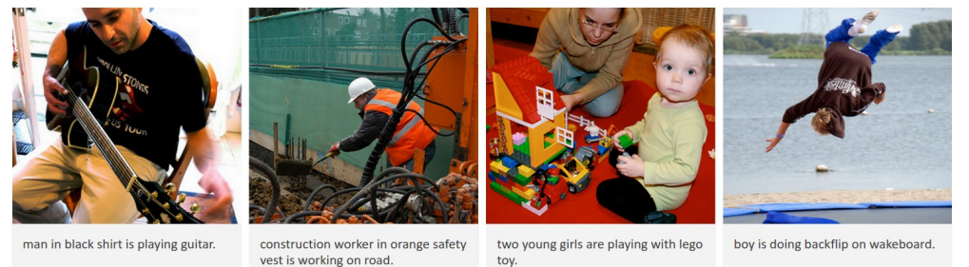
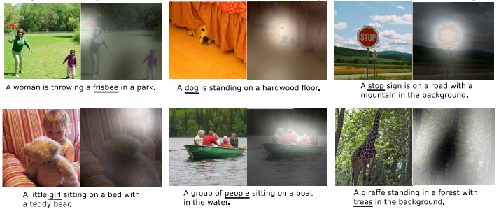
Image captioning examples

Slide 10
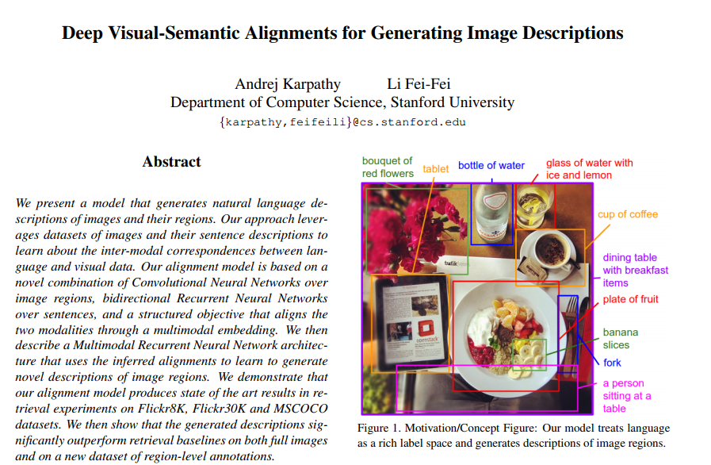
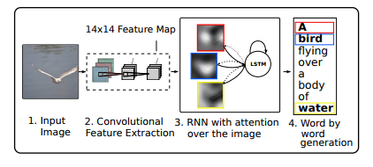
Image captioning models

Slide 11
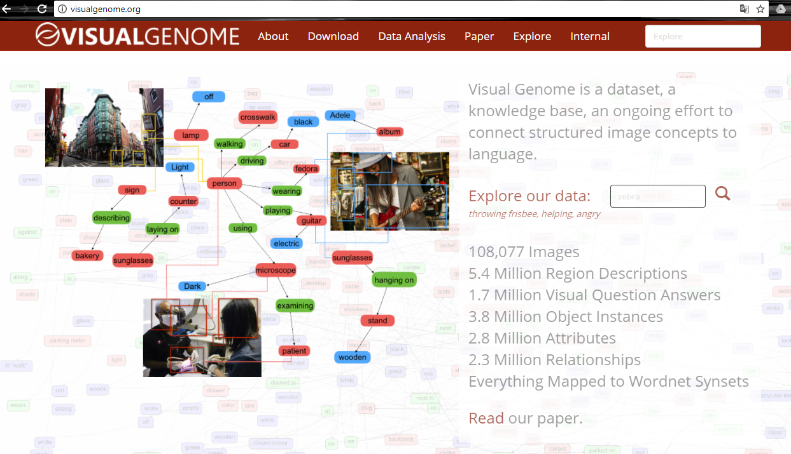
Image captioning datasets

Slide 12
Understanding Image: Visual Question Answering (VQA)

Slide 13
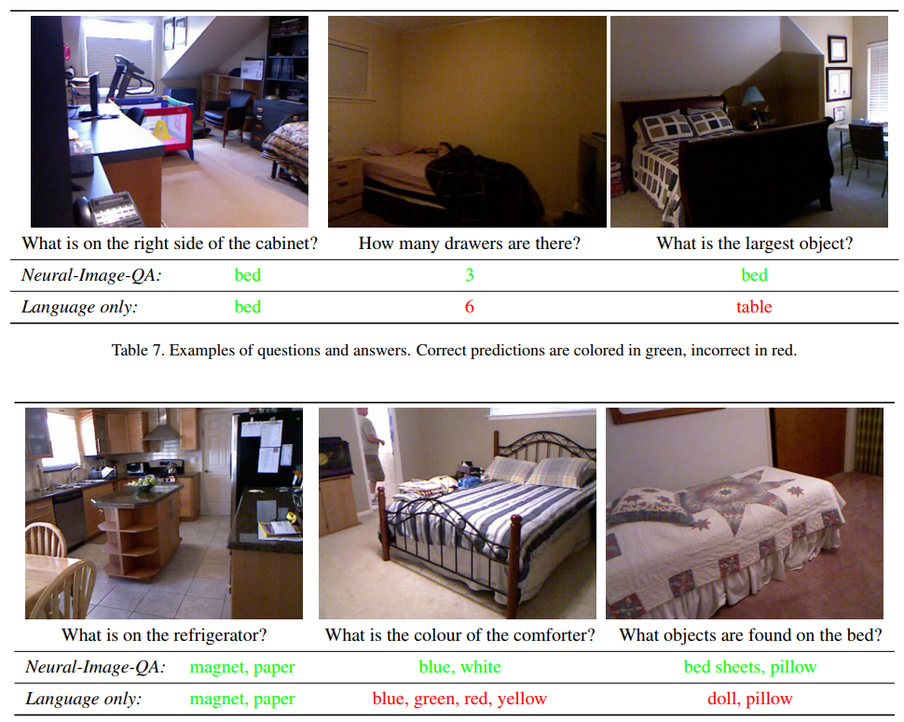
VQA examples

Slide 14
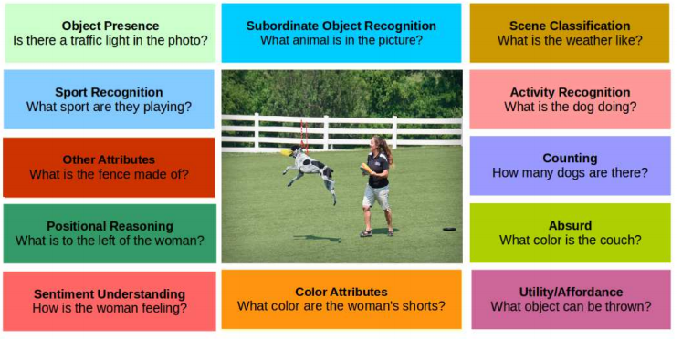
VQA questions categories

Slide 15
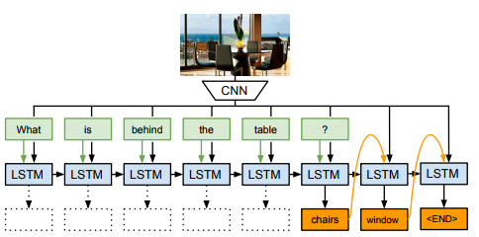
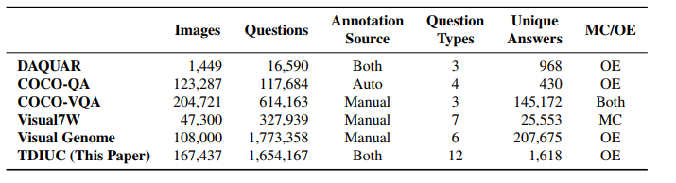
VQA models and datasets

Slide 16
Understanding Image: Visual Dialog

Slide 17
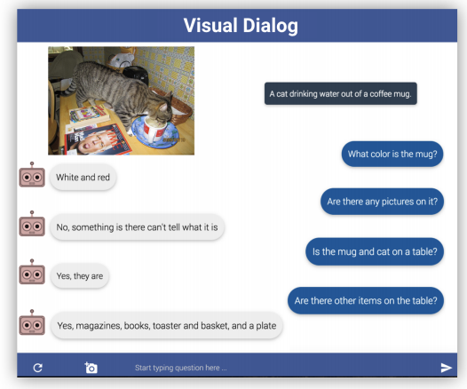
Visual dialog example

Slide 18
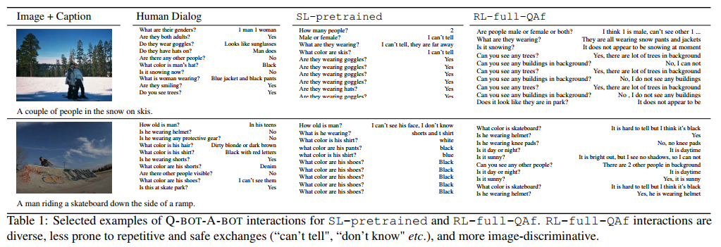
Visual dialog example

Slide 19
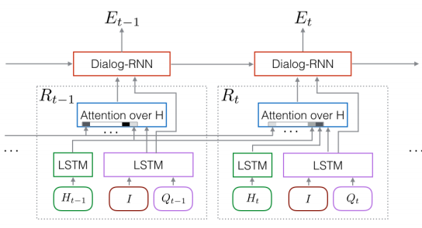
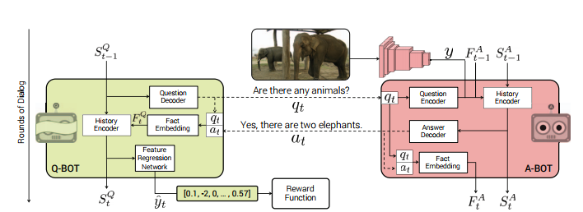
Visual dialog models

Slide 20
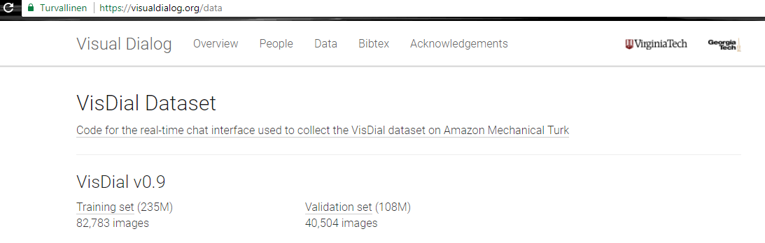
Visual dialog datasets

Slide 21
Undestanding Image: The Big Problem

Slide 22
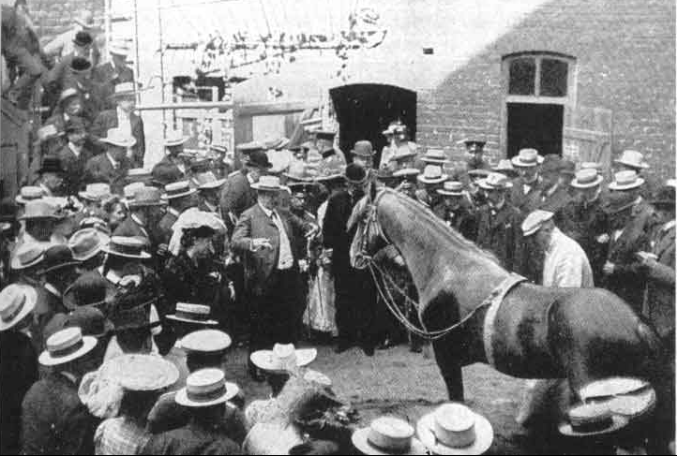
Clever Hans
(by Larry Zitnick, 29.10.2017)

Slide 23
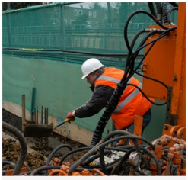
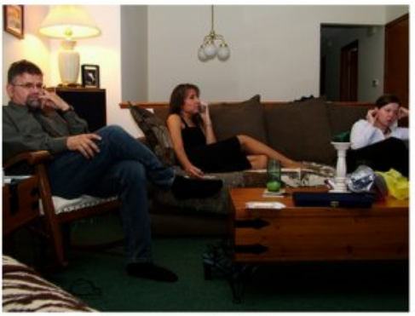
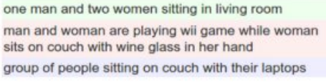
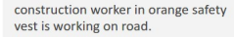
Current methods are inexplicable mappings from image to language
?
?

Slide 24
Understanding Image: Visual Reasoning

Slide 25
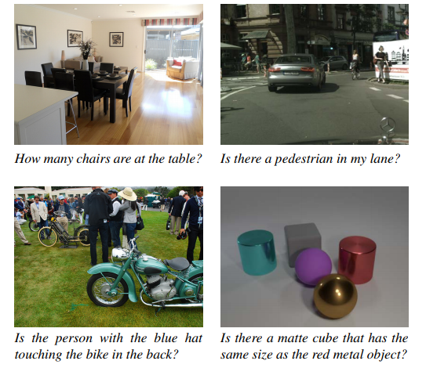
Visual reasoning example

Slide 26
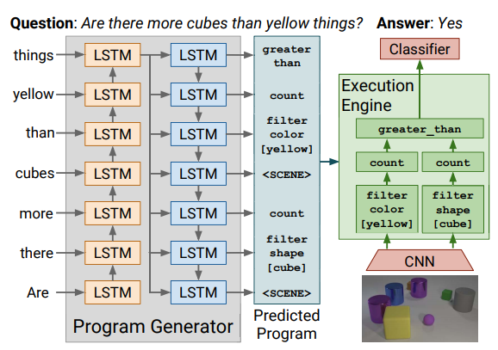
Visual reasoning models

Slide 27
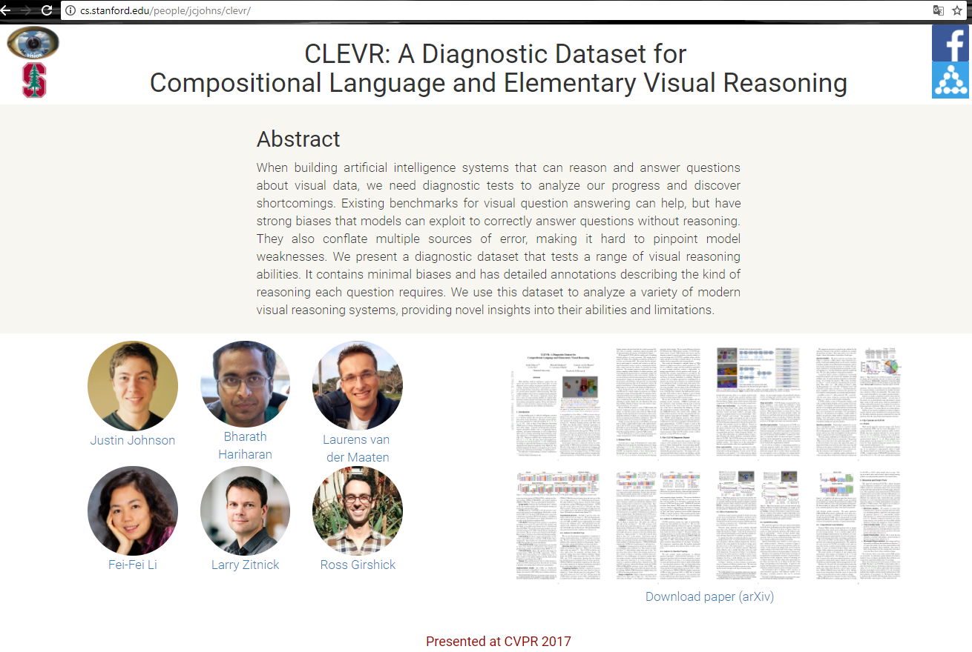
Visual reasoning datasets

Slide 28
Thesis

Slide 29
Preliminary work 2017
Richard Szeliski: “Computer Vision: Algorithms and Applications”
Sebastian Thrun, Wolfram Burgard, Dieter Fox: “Probabilistic Robotics”
Kevin P. Murphy: ”Machine Learning. A Probabilistic Perspective”
Stanford CS231n: ”Convolutional Neural Networks for Visual Recognition” (YouTube)
Udacity: ”Introduction to Computer Vision” (YouTube)
Udacity: ”Intro to Machine Learning” (YouTube)
Udacity: ”Machine Learning” (YouTube)
Udacity: ”Computational Photography” (YouTube)
Daphne Koller: ”Probabilistic Graphical Models” (YouTube)
Reviews on calculus, linear algebra, statistics, probability, …
Kaggle competition
Matlab, Python
ICCV 2017

Slide 30
Title:
Image-Based Situation Awareness
Doctoral Programme:
TUT Engineering Sciences, TTITO
Faculty:
Department of Automation Science and Engineering
Supervisor:
Professor Risto Ritala
Approved:
8.12.2017
Schedule:
2018-2021
General information

Slide 31
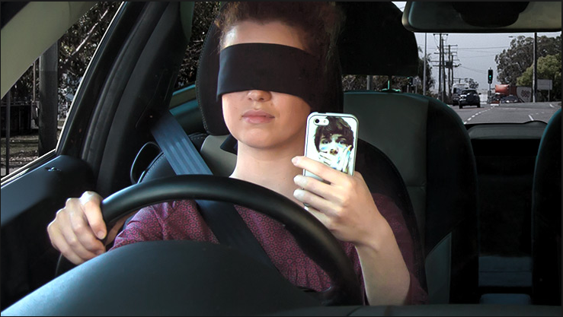
“Develop methods which can perceive the elements in the environment
within a volume of time and space, comprehend their meaning and
project their status in the near future. The methods will be tested on a
system which will help visually impaired people to understand their
environment better. The system will be demonstrated on existing
hardware.”
Goal

Slide 32
Reserch questions
By which methods an image-based perception of the environment can be produced, including object detection and localization in the field of view context?
By which methods a comprehension of the situation can be produced? This includes estimating object locations and their velocities in a 3d coordinate system, also for currently hidden objects.
By which methods a future projection of the situation can be created?
By which methods the comprehension and the future projection can be translated into human language?
How are uncertainty and reliability considered and represented?

Slide 33
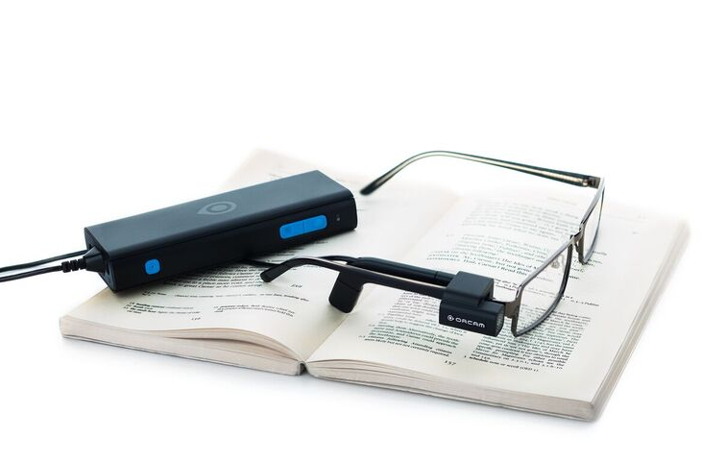

Prototype
OrCam MyEye 2.0
“For blind and partially sighted people, an artificial vision device with a lightweight smart camera that instantly reads text aloud - from any surface – and recognizes faces, products, and money notes in real time.”
Thesis Prototype
A reliable and fast system which can help a visually impaired person to understand her environment better by accurate and rich description. This is accomplished by
capturing images
detecting objects
comprehending situation
describing environment
projecting future
implying warnings
The system will be demonstrated on physical hardware, preferably mobile.

Slide 34

Schedule

Slide 35
2018-2019
TTI-90006 Orientation to Doctoral Studies, 3 cr
BMT-51506 Human Visual System, 5 cr
ASE-7516 Dynamic Planning with Incomplete Information, 5 cr
2019-2020
SGN-31007 Advanced Image Processing, 5 cr
ASE-7536 Model-Based Estimation, 5-7 cr
SGN-25006 Vector Space Methods for Signal and Image Processing, 5 cr
2020-2021
MAT-75006 Artificial Intelligence, 7 cr
SGN-43006 Knowledge Mining and Big Data, 5 cr
TTI-90016 Essay on Philosophy of Science/Research Ethics, 2 cr
Supporting studies
Goodfellow, Bengio, Courville: “Deep Learning”
Udacity, Youtube courses on machine learning and computer vision

Slide 36
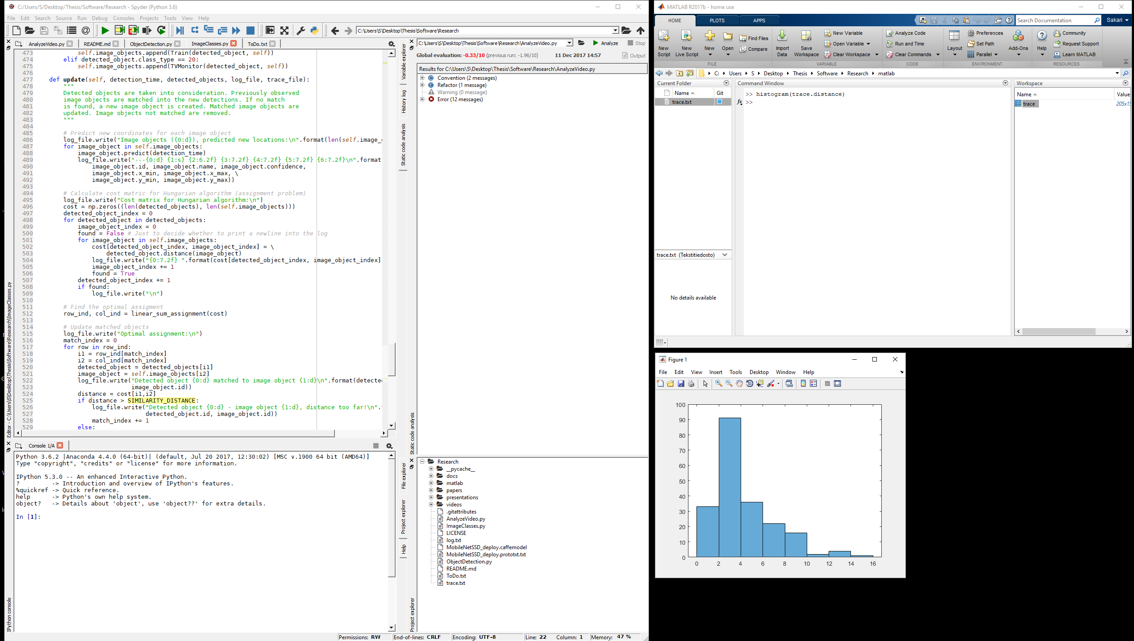
Software
Matlab
Python, Anaconda, Spyder
OpenCV
Keras, TensorFlow, (TensorFlow Lite, if required)
NumPy, Pandas, MatPlotLib, SkLearn, SciPy, SeaBorn,…
(PyTorch, Caffe2Go, if required)
Visual Studio - prototype user interface
Hardware
Intel i7-4790 4GHz / 16Gt Ram
NVIDIA GeForce GTX 780 Ti (CUDA)
(Google Cloud Platform, if required)
Research environment

Slide 37
Software architecture
Research environment
Video file
Camera
OpenCV
AnalyzeVideo
ObjectDetection
ImageClasses
MobileNetSSD (caffe)

Slide 38
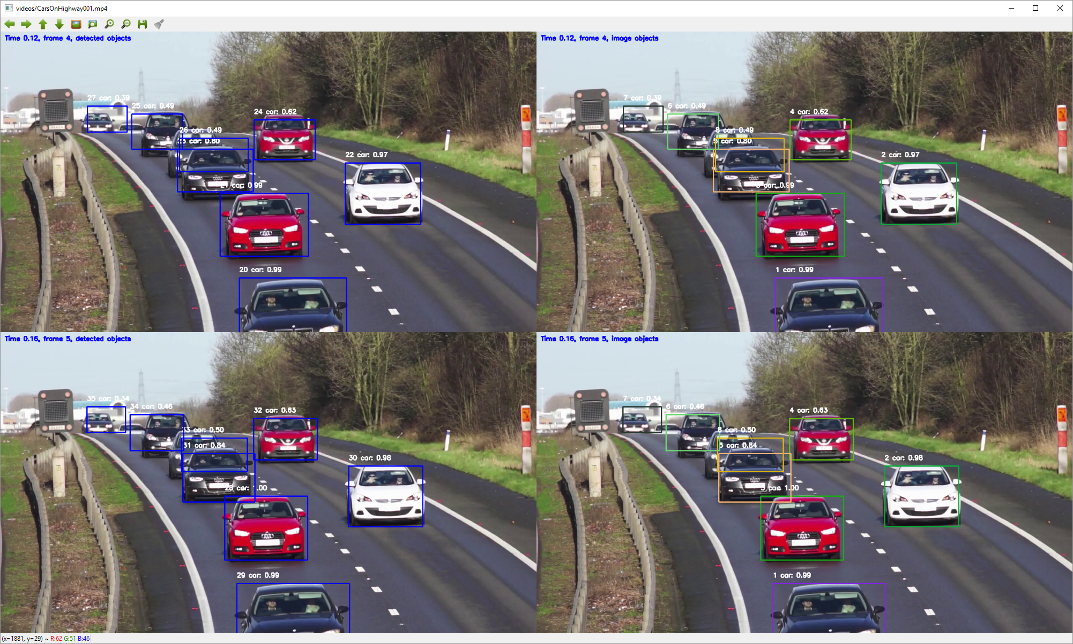
Research environment
Video processing, frame by frame
Python 3.6.2, OpenCV 3.3.0
Single Shot Detector + MobileNets (Google)

Slide 39
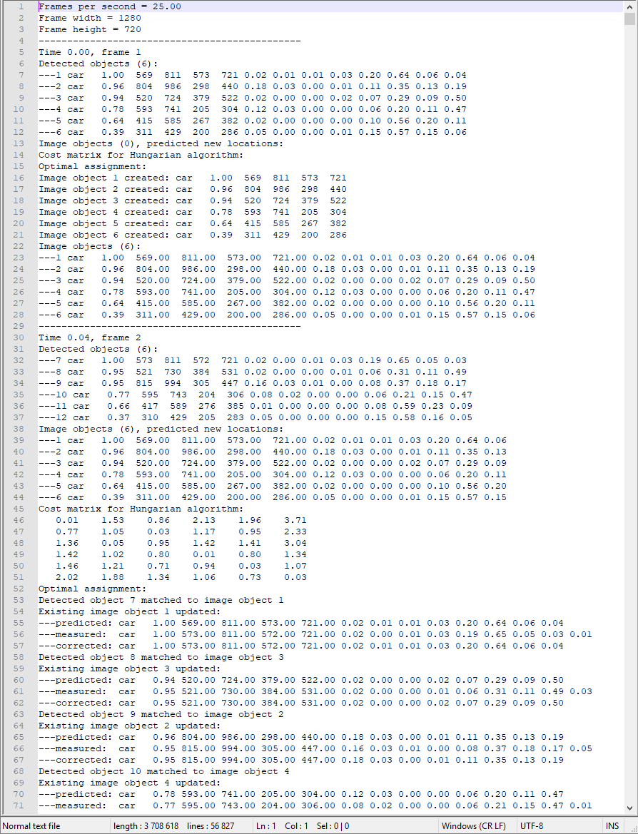

Research environment
Detailed log for every frame
Trace file for external analysis

Slide 40

GitHub
https://github.com/SakariLampola/Thesis

Slide 41
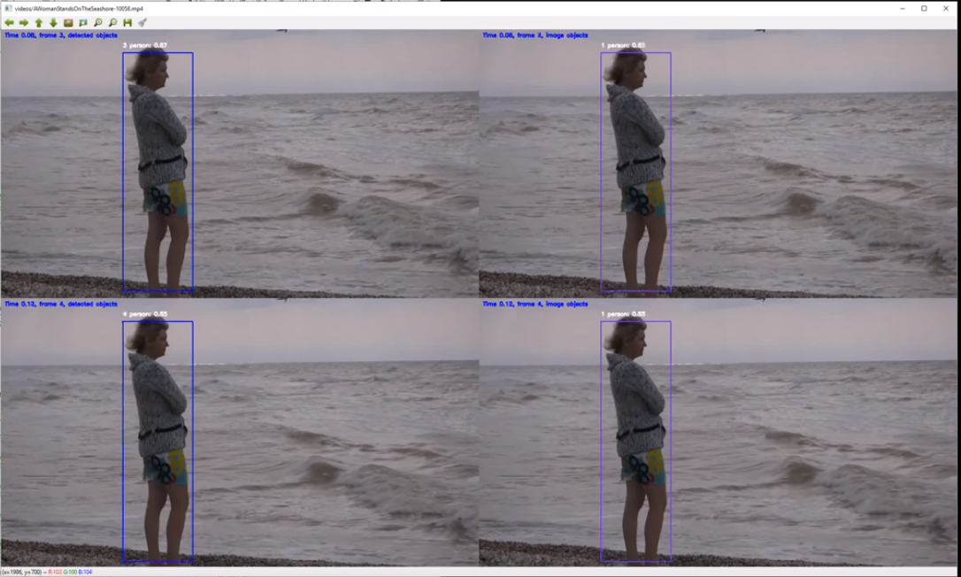
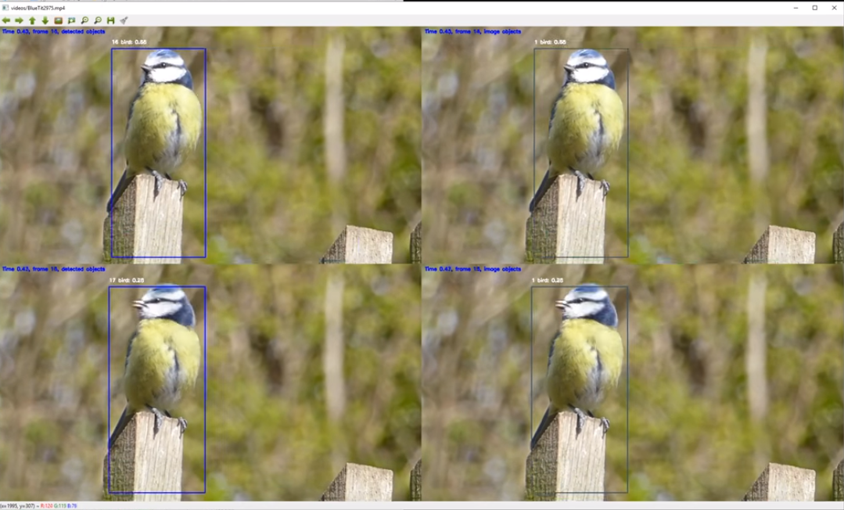
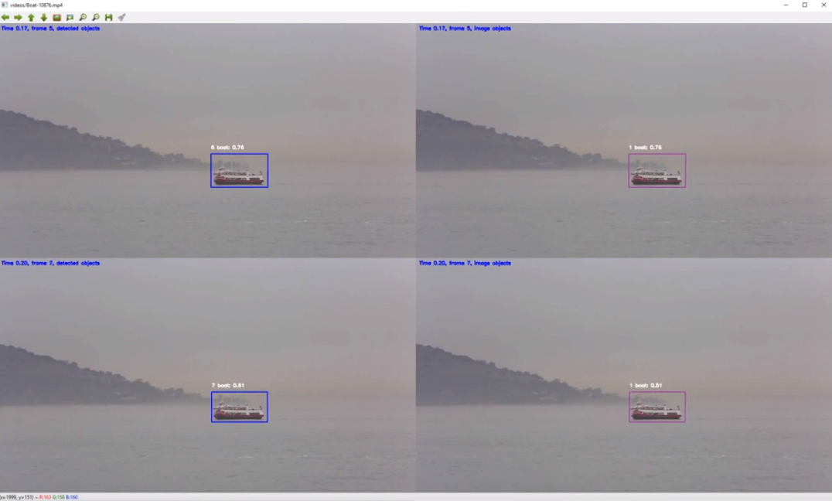
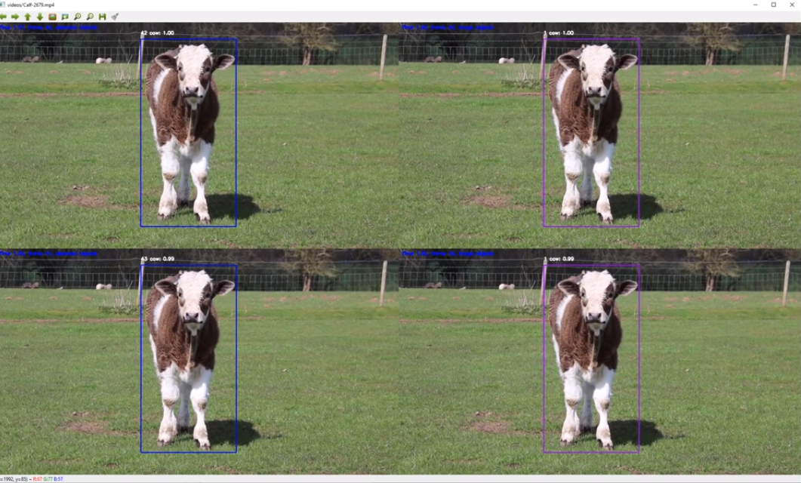
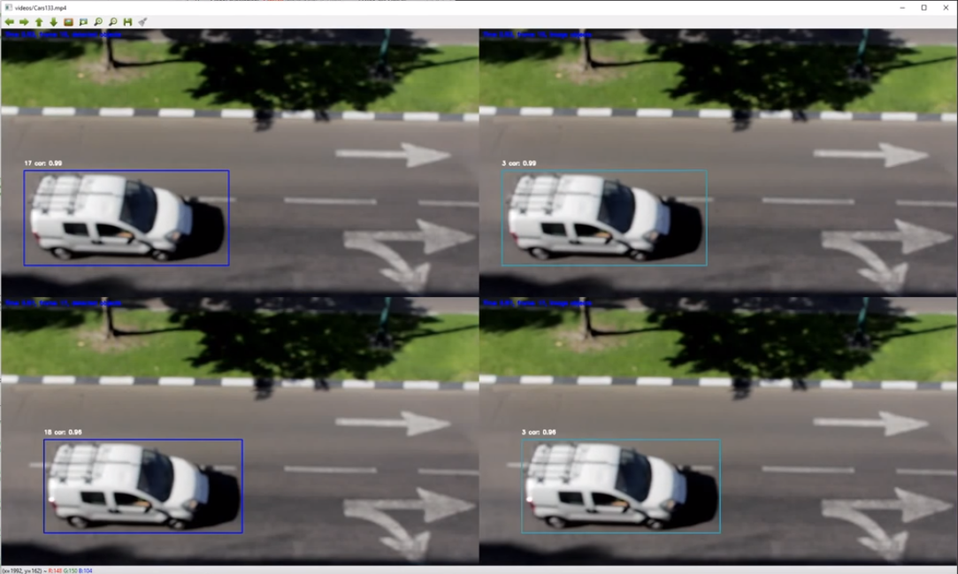
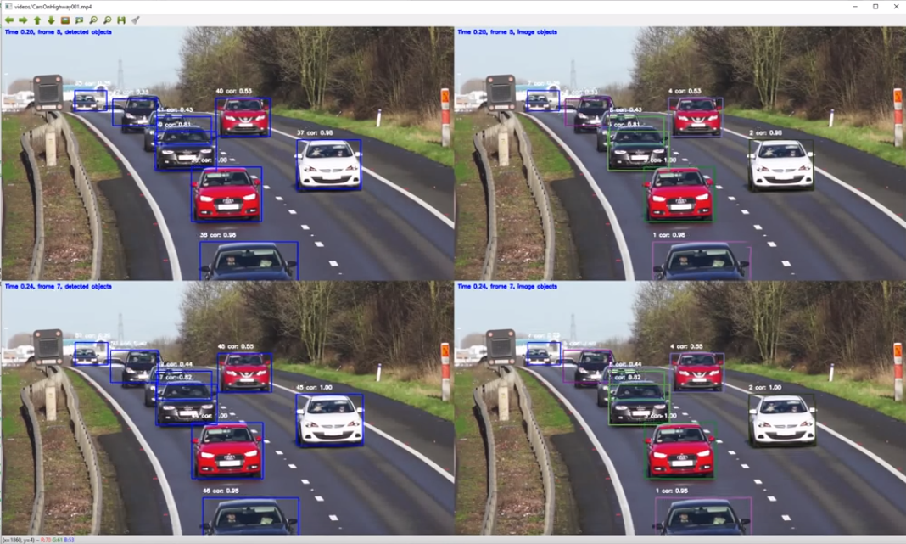
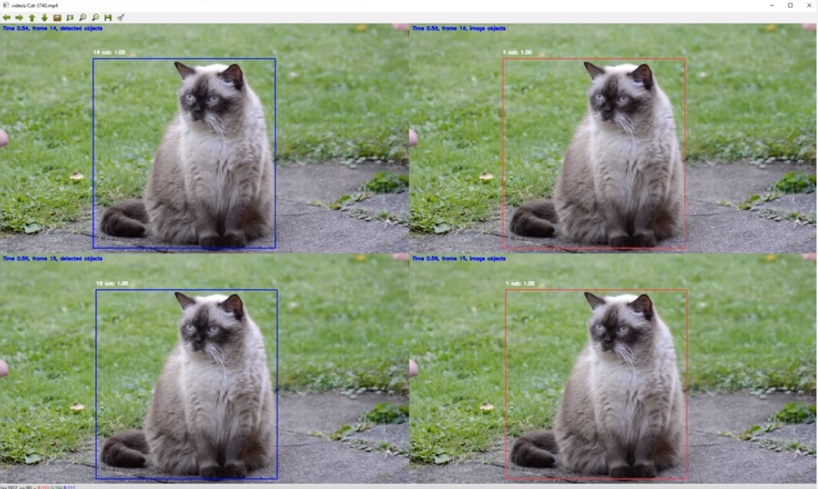
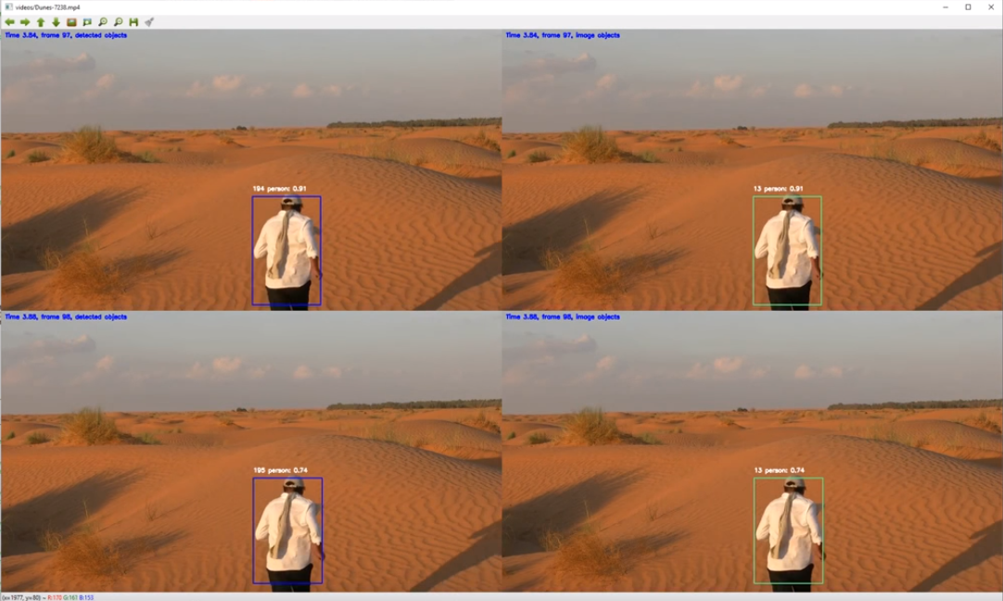
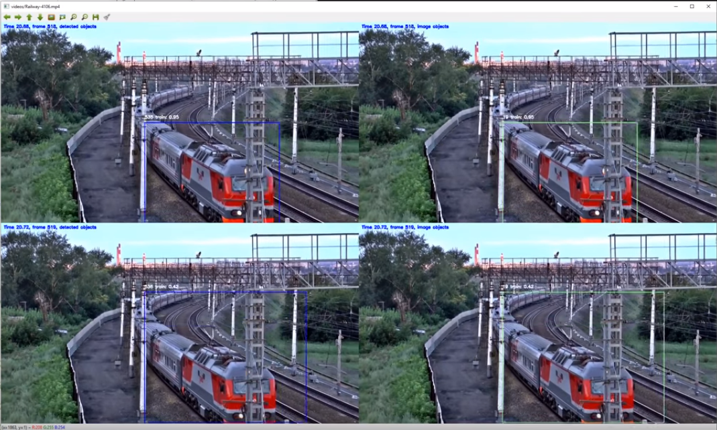
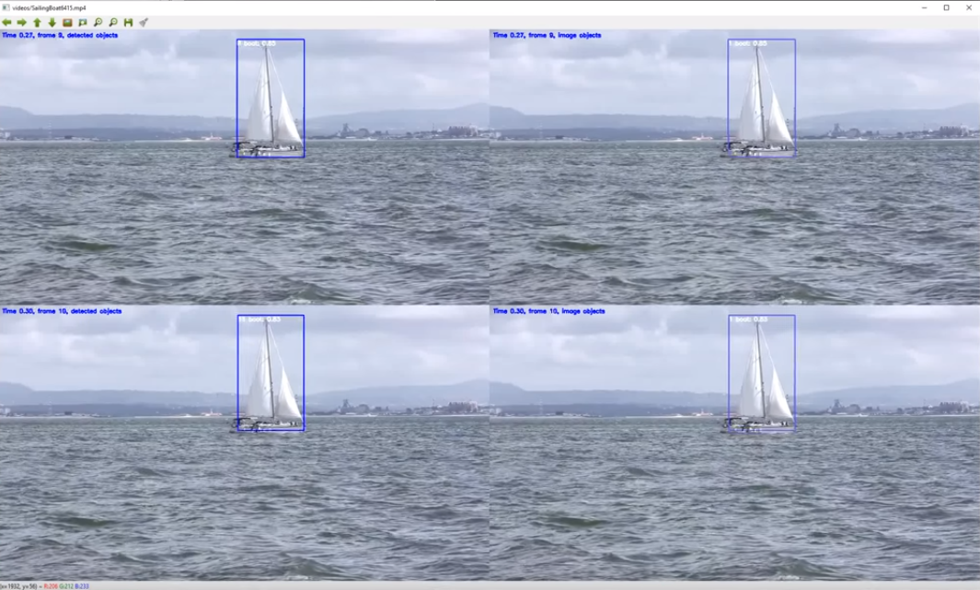
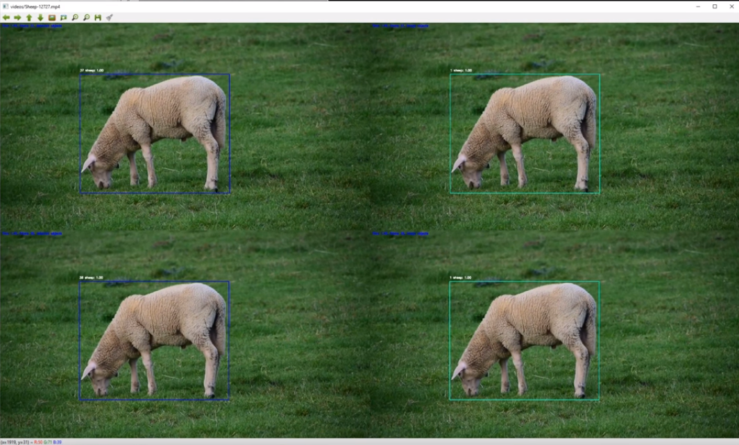
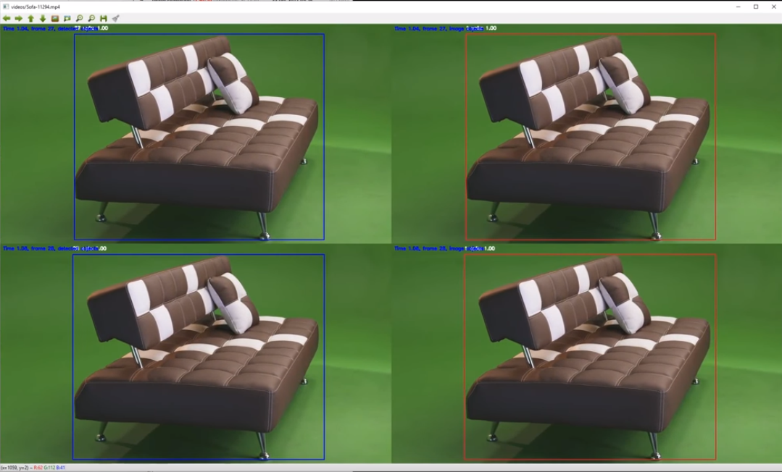
Demos
YouTube channel: Sakari Lampola

Slide 42
Situation Awareness

Slide 43
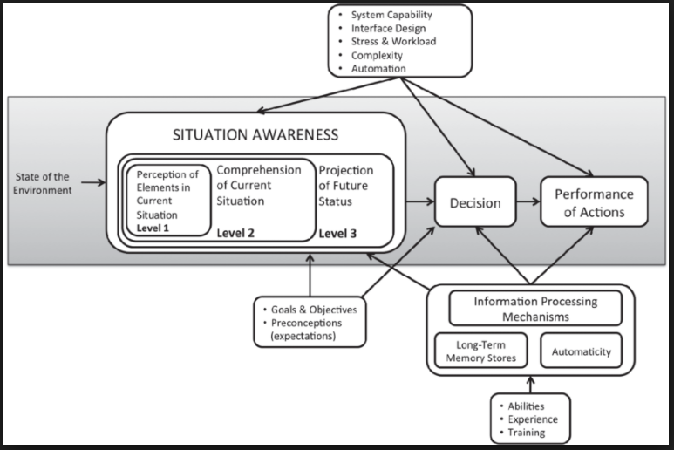
Wikipedia:
Situational awareness or situation awareness (SA) is the perception
of environmental elements and events with respect to time or space,
the comprehension of their meaning, and the projection of their status
after some variable has changed, such as time, or some other variable,
such as a predetermined event.
It is also a field of study concerned with understanding of the environment
critical to decision-makers in complex, dynamic areas from aviation, air
traffic control, ship navigation, power plant operations, military command
and control, and emergency services such as fire fighting and policing; to
more ordinary but nevertheless complex tasks such as driving an automobile
or riding a bicycle.
Definition

Slide 44
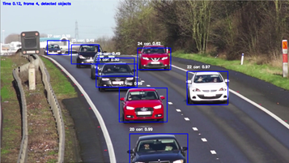
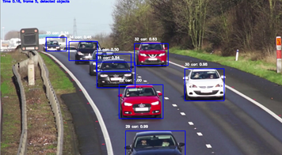
Endsley’s model:
Perception of the elements in the current situation
Comprehension of the current situation
Projection of future status of the situation
Levels
N. A. Stanton, P. R. G. Chambers, and J. Piggott, “Situational awareness and safety,” Safety Sci., vol. 39, no. 3, pp. 189–204, 2001

Slide 45
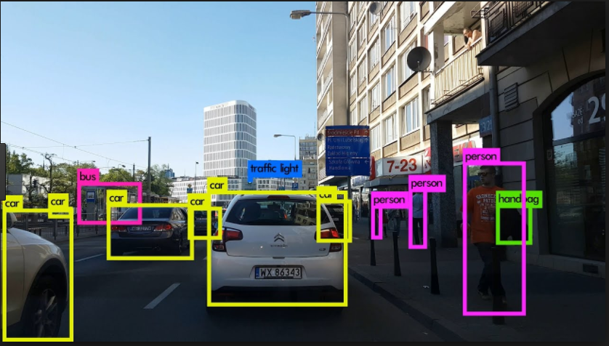
Perception of the elements in the current situation
Perception
Object detection
Algorithms:
Faster R-CNN
YOLO
SSD
…
Output
Classification
Bounding box
Reliability index
“The first step in achieving SA is to perceive the status, attributes, and dynamics of relevant elements in the environment. Thus, Level 1 SA, the most basic level of SA, involves the processes of monitoring, cue detection, and simple recognition, which lead to an awareness of multiple situational elements (objects, events, people, systems, environmental factors) and their current states (locations, conditions, modes, actions).”

Slide 46
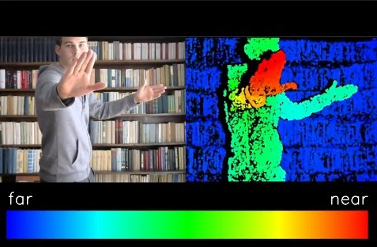
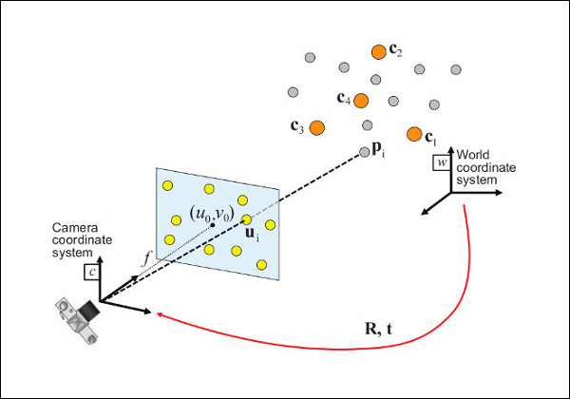
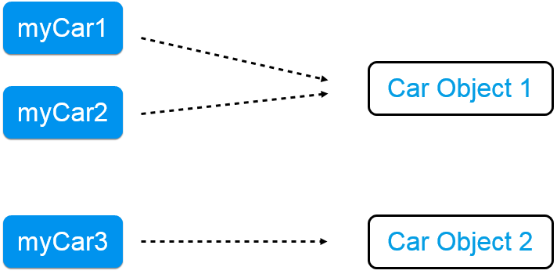

Comprehension of the current situation
Comprehension
Algorithms:
BOOSTING
MIL
KCF
TLD
MEDIANFLOW
GOTURN
…
“The next step in SA formation involves a synthesis of disjointed Level 1 SA elements through the processes of pattern recognition, interpretation, and evaluation. Level 2 SA requires integrating this information to understand how it will impact upon the individual's goals and objectives. This includes developing a comprehensive picture of the world, or of that portion of the world of concern to the individual.”

Slide 47

Projection of future status of the situation
Projection
Language
“The third and highest level of SA involves the ability to project the future actions of the elements in the environment. Level 3 SA is achieved through knowledge of the status and dynamics of the elements and comprehension of the situation (Levels 1 and 2 SA), and then extrapolating this information forward in time to determine how it will affect future states of the operational environment.”

Slide 48
Work in Progress

Slide 49
Perception
“The first step in achieving SA is to perceive the status, attributes, and dynamics of relevant elements in the environment. Thus, Level 1 SA, the most basic level of SA, involves the processes of monitoring, cue detection, and simple recognition, which lead to an awareness of multiple situational elements (objects, events, people, systems, environmental factors) and their current states (locations, conditions, modes, actions).”

Slide 50

Object detection
Perception

Slide 51



SSD + MobileNet
Perception

Slide 52

Result
Perception
Detected object
x_min
x_max
y_min
y_max
class
confidence
+
appearance

Slide 53




Appearance : hue histogram, 8 bins
Perception
Red car
Blue car
White car
Black car

Slide 54
Appearance : hue histogram, 8 bins
Perception
RGB
HSV
Why hue?
V (value) is sensitive to lighting, shadows
S (saturation) is sensitive to dust, fog, distance
Why 8 bins?
Arbitrary decision
Value range 0…179
Used in other CV algorithms (Sift)

Slide 55
Comprehension
“The next step in SA formation involves a synthesis of disjointed Level 1 SA elements through the processes of pattern recognition, interpretation, and evaluation. Level 2 SA requires integrating this information to understand how it will impact upon the individual's goals and objectives. This includes developing a comprehensive picture of the world, or of that portion of the world of concern to the individual.”

Slide 56

Entity definitions
Comprehension
Detected Object
Image Object
World Object
Detected object: Output from an object detector, no persistency. Measurement.
Image object:
Persistent object created and updated by detected objects.
World object:
Object living in a 3d world with state: including location, velocity and acceleration. Updated by projected image object.

Slide 57

Image object identity
Comprehension

Slide 58

Image object
Perception
Image object
id
status
x_min
x_max
y_min
y_max
vx_min
vx_max
vy_min
vy_max
class
confidence
appearance

Slide 59
Matching detected and image objects
Comprehension
1
1
3
2
Detected object
Image object (predicted)
Detected object and image object are ”near” each other. Image object updated according to the detected object.
Detected object without any nearby image objects. A new image object is created according to the detected object.
Image object without any nearby detected objects. The image object status is changed to ’Hidden’. Movement prediction continues until out of frame.

Slide 60

Distance metrics
Comprehension
Detected object
Image object (predicted)

Slide 61
Probabilistic approach
Image object 1 (io₁)
id
status
x_min
x_max
y_min
y_max
vx_min
vx_max
vy_min
vy_max
class
confidence
appearance
Comprehension
Detected object (do)
x_min
x_max
y_min
y_max
class
confidence
+
appearance
Feature vector f
x_min
x_max
y_min
y_max
class ??
confidence
appearance
Image object 2 (io₂)
id
status
x_min
x_max
y_min
y_max
vx_min
vx_max
vy_min
vy_max
class
confidence
appearance
P(do = io_{i}) ~ N(f_{io} – f_{do,i} ∣ 0 , V_{f})
V_{f} estimated using comprehensive simulation
-log(P) used as distance (cost)

Slide 62



Matching algorithm
Comprehension

Slide 63

Matching algorithm
Comprehension

Slide 64

Matching algorithm
Comprehension
Open question: Role of classical algorithms?
MeanShift
CamShift
Optical flow (Lucas-Kanade)
Background Subtraction
Possible added value:
Refined object region
Support for occasionally missing bounding boxes

Slide 65

Special cases / Vanishing detected objects
Comprehension
Solution: Image objects have statuses. Their location is predicted according to the previous location and velocity. When no matching detected objects exist, image objects are not immediately removed, but their status is changed (’detected’-> ’hidden’). Prediction continues in following frames.

Slide 66

Special cases / Multiple classifications
Comprehension
Solution: The classification with highest confidence is used if multiple detected
objects correspond to an image object and no other image object is nearby. The
information is available in the Hungarian algorithm cost matrix.

Slide 67

Special cases / Multiple bounding boxes (a)
Comprehension
Solution: ?
Open question: What to do?

Slide 68

Special cases / Multiple bounding boxes (b)
Comprehension

Slide 69

Special cases / Multiple bounding boxes (c)
Comprehension

Slide 70

Special cases / Typical background elements are messed
up with object in the classification. (a)
Comprehension
Solution: Classification confidence must be high enough for creating a new image
object. Probabilistic estimate based on distance and a priori size.
Open question: How to determine the appropriate minimum confidence level?

Slide 71

Special cases / Typical background elements are messed
up with object in the classification. (b)
Comprehension

Slide 72

Special cases / False detections inside other objects
Comprehension
Solution: ?
Open question: What to do?

Slide 73
Image object location and velocity prediction
Comprehension
3
Detected object
Image object (current)
Image object (predicted)

Slide 74


Image object location and velocity prediction
Comprehension
location
velocity

Slide 75

Image object location and velocity prediction
Comprehension

Slide 76

Image object location and velocity prediction
Comprehension

Slide 77


Image object location and velocity prediction
Comprehension

Slide 78

Image object location and velocity prediction
Comprehension
location
velocity

Slide 79

Image object location and velocity prediction
Comprehension
Location, measured and filtered
Estimated velocity

Slide 80

Image object location and velocity prediction
Comprehension
Prediction error using previous measurement
Prediction error using filtered prediction

Slide 81
Image object location and velocity prediction
Comprehension
Open questions:
How to set covariances and initialize sigma?
How to predict when using previous measurement gives smaller average error? Bias!
(Notebook demo)

Slide 82
Next Steps

Slide 83
Next steps
Comprehension:
Closing the open questions
2d -> 3d transformation
World object state estimation

Slide 84




2d -> 3d transformation
Next steps
Open question: How to create the reverse transformation?

Slide 85

2d -> 3d transformation (a priori size for distance estimation)
Next steps

Slide 86

World object state estimation
Next steps

Slide 87


World object state estimation
Next steps

Slide 88

World object state estimation
Next steps

Slide 89

World object state estimation
Next steps
Open questions:
Equations ok?
Initial values?
Different time step for prediction, not equal to inverse video frame rate?

Slide 90
To Be Discussed

Slide 91
Method follow-up
Google search enough?
Good way of following new papers?

Slide 92
Actions
The role of actions, should it be considered?
Navigation assistance?

Slide 93
Probability there is something in the image
P(S)
Probability of class given that there is something
P(C|S)
Probability of location (or state) given the class
P(X|C,S)
Probability representation
What is the goal?
“Develop methods which can perceive the elements in the environment
within a volume of time and space, comprehend their meaning and
project their status in the near future. The methods will be tested on a
system which will help visually impaired people to understand their
environment better. The system will be demonstrated on existing
hardware.”
Goodfellow, Bengio, Courville: “Deep Learning”

Slide 94
Ingredients:
Classification belief
Bounding box noise
Pixel discretization
Distance estimation
Sources of uncertainty
Inherent stochasticity in the system being modeled.
?
Incomplete observability.
?
Incomplete modeling.
?
Goodfellow, Bengio, Courville: “Deep Learning”

Slide 95
“Develop methods which can perceive the elements in the environment
within a volume of time and space, comprehend their meaning and
project their status in the near future. The methods will be tested on a
system which will help visually impaired people to understand their
environment better. The system will be demonstrated on existing
hardware.”
Goal Fine Tuning
What is the goal in practice?
What is the output of the system?
Goodfellow, Bengio, Courville: “Deep Learning”

Slide 96
Thank you!
lampola@student.tut.fi
https://github.com/SakariLampola/Thesis

